Slide 1


Platform
of Insights
Schmitt | Cotte | Giesler | Stephen | Wood
October 2021
AE/ERB Meeting
Bernd Schmitt
June Cotte
Markus Giesler
Andrew Stephen
Stacy Wood

Slide 2

Thank you from us!

Slide 3
Our Journal:
Structure and People

Slide 4

Structure
& People
Robert J. Meyer
Richard Wilk
Geeta Menon
Amber Epp
Allison J. Pugh
Fred M. Feinberg
Carolyn Yoon
Donald R. Lehmann
Tina M. Lowrey
Michel Tuan Pham
Bernd Wittenbrink
The JCR
Policy Board

Slide 5


Editorial Leadership
Editor in Chief
Bernd Schmitt
Columbia University
Editors
June Cotte
Western University
Markus Giesler
York University
Andrew Stephen
Oxford University
Stacy Wood
NC State University
Special Guest Editor
Richard Lutz
University of Florida
Vlad Dovijarov
Managing Editor
Andrew Edelblum
Social Media Manager

Slide 6


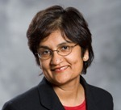

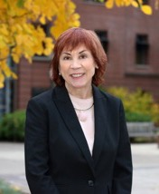

Slide 7
Our Associate Editors
Zeynep Arsel, Concordia University
Rajesh Bagchi, Virginia Tech
Marco Bertini, Esade
Simon Blanchard, Georgetown University
Lisa Bolton, Pennsylvania State University
Simona Botti, London Business School
Susan Broniarczyk, University of Texas at Austin
Julien Cayla, Nanyang Technological University
Haipeng (Allan) Chen, University of Kentucky
David Crockett, University of South Carolina
David Dubois, INSEAD
Giana Eckhardt, King’s College London
Christoph Fuchs, Technical University of Munich
Andrew Gershoff, University of Texas at Austin
Jacob Goldenberg, IDC Herzliya
Donna Hoffman, George Washington University
Wayne Hoyer, Univ. of Texas-Austin
Szu-chi Huang, Stanford University
Ashlee Humphreys, Northwestern University
Anat Keinan, Boston University
Aradhna Krishna, University of Michigan
Ellie Kyung, University of Pennsylvania
Leonard Lee, National University of Singapore
Brent McFerran, Simon Fraser University
Tom Meyvis, New York University
Ashwani Monga, Rutgers University
Sarah Moore, University of Alberta
Carey Morewedge, Boston University
Theodore Noseworthy, York University
Thomas Novak, George Washington University
Nailya Ordabayeva, Boston College
Vanessa Patrick, University of Houston
Koen Pauwels, Northeastern University
Stefano Puntoni, Erasmus University
Rebecca Ratner, University of Maryland
Rebecca Walker Reczek, Ohio State University
David Schweidel, Emory University
Maura Scott, Florida State University
Jaideep Sengupta, HKUST
Stephen Spiller, UCLA
Manoj Thomas, Cornell University
Carlos Torelli, University of Illinois
Oleg Urminsky, University of Chicago
Echo Wen Wan, University of Hong Kong
Klaus Wertenbroch, INSEAD
Keith Wilcox, Texas A&M University
Lawrence Williams, University of Colorado

Slide 8
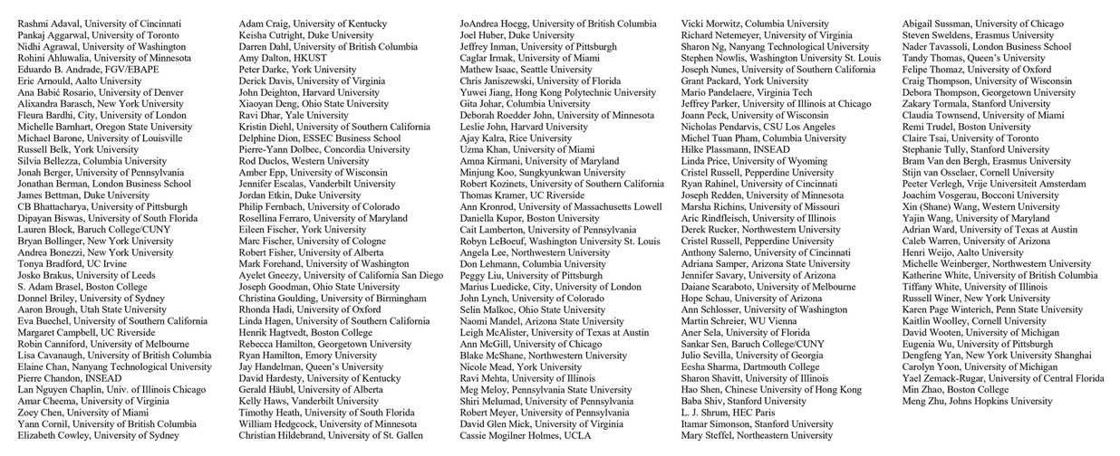
Our Editorial Review Board Members

Slide 9
AEs and ERB Members by Year
Year | AEs | ERBs
2014 | 24 | 164
2015 | 25 | 163
2016 | 29 | 197
2017 | 31 | 202
2018 | 35 | 184
2018 | 35 | 189
2020 | 40 | 173
2021 | 47 | 181

Slide 10
Outstanding Reviewer Awards
Reviews: 6 or more
Average score: Above 4 (out of 5)
Turnaround: Less than 28 days
Not a 2020 winner (share the love!)
Criteria

Slide 11
Outstanding Reviewer Awards
Pankaj Aggarwal, University of Toronto
Eduardo B. Andrade, Fundação Getulio Vargas/EBAPE
Andrea Bonezzi, New York University
Aaron R. Brough, Utah State University
Darren W. Dahl, University of British Columbia
Derick F. Davis, University of Virginia
Eileen Fischer, York University
Joseph K. Goodman, Ohio State University
Henrik Hagtvedt, Boston College
Cait Lamberton, University of Pennsylvania
Grant Packard, York University
Mario Pandelaere, Virginia Tech
Jeffrey R. Parker, University of Illinois at Chicago
Daiane Scaraboto, University of Melbourne
Abigail Sussman, University of Chicago
Felipe Thomaz, University of Oxford
Yajin Wang, University of Maryland
Karen Page Winterich, Pennsylvania State University
Winners

Slide 12
Metrics
Timeliness
and Speed

Slide 13
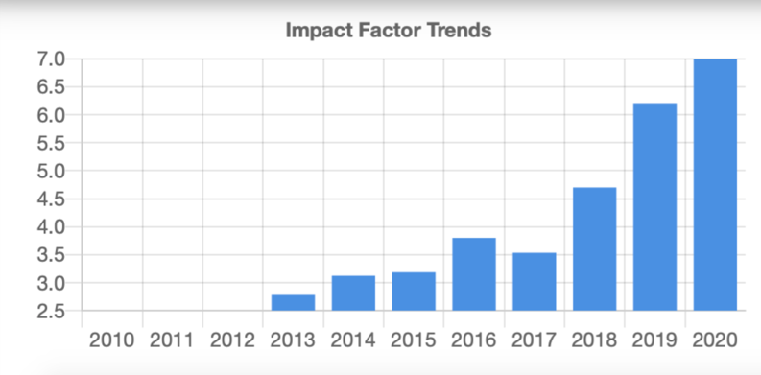
2020 Impact Factor: 6.99

Slide 14
Impact Factor Comparison
2020 Rank | 2019 Rank | 2018 Rank | 2017 Rank | Journal | 2020 Impact Factor
1 | 1 | 4 | 5 | Administrative Science Quarterly | 11.113
2 | 7 | 2 | 3 | Journal of Marketing | 9.462
3 | 2 | 1 | 1 | Journal of the Academy of Marketing Science | 9.418
4 | 3 | 5 | 4 | Journal of Personality and Social Psychology | 7.673
5 | 6 | 3 | 2 | Psychological Science | 7.029
6 | 4 | 8 | 6 | Journal of Consumer Research | 7.000
7 | 5 | 6 | 7 | Journal of Retailing | 5.245
8 | 8 | 7 | 8 | Journal of Marketing Research | 5.000
9 | 9 | 11 | 12 | International Journal of Research in Marketing | 4.513
10 | 12 | 12 | 11 | Journal of Public Policy & Marketing | 4.500
11 | 10 | 10 | 10 | Marketing Science | 3.716
12 | 11 | 9 | 9 | Journal of Consumer Psychology | 3.330

Slide 15
Submissions
Editors | Year | New Submissions | Revised Submissions | Total Submissions | Desk Reject Rate
Inman/Schmitt Teams | 2021 | 561 | 201 | 762 | 54%
Inman Team | 2020 | 538 | 183 | 721 | 48%
Inman Team | 2019 | 462 | 167 | 629 | 45%
Dahl/Inman Teams | 2018 | 571 | 242 | 813 | 47%
Dahl Team | 2017 | 598 | 207 | 805 | 37%
Dahl Team | 2016 | 540 | 197 | 737 | 34%
Dahl Team | 2015 | 556 | 156 | 712 | 33%
McGill/Dahl Teams | 2014 | 483 | 198 | 681 | 34%
McGill Team | 2013 | 449 | 170 | 619 | 36%
McGill Team | 2012 | 521 | 122 | 643 | 34%

Slide 16
Review Time (Days)
 | ME Checks and Sends to EIC | EIC Assigns Editor | Editor Assigns AE | Editor Invites First Reviewer | Last Review Received | AE Report | Editor Decision | Total Turnaround
New Papers Sent for Review | 0.6 | 0.1 | 1.8 | 3.7 | 31.0 | 10.0 | 4.5 | 51.8
Desk Rejects (with AE Input) | 0.6 | 0.1 | 1.2 |  |  | 3.2 | 1.8 | 7.0
Immediate Desk Rejects | 0.6 | 0.1 |  |  |  |  | 1.4 | 2.1
Revisions | 0.9 |  |  | 1.9 | 30.2 | 8.7 | 3.6 | 45.3
Average Reviewer Turnaround = 23.2 days

Slide 17
How do we ensure a timely process?
Timeliness at front and back end
Reminders
Clear rules and expectations (and no exceptions):
Paper: 60 pages (or less)
Revision notes: 15 pages (or less)
One year for revision

Slide 18




Initiatives
Journal
Content
Diversity,
Equity, and Inclusion
Data Policies
Website/ Community

Slide 19
Journal
Content

Slide 20
Consumer Relevance and Contribution Statement
Journal
Content
Insights into consumers
and consumption in the marketplace
“The purpose of the statement is for you to show how the paper aligns with the mission of the journal by providing a clear and concise understanding of the primary consumer insights, the contribution of your manuscript beyond extant consumer research, and the relevance of your findings to appropriate non-academic audiences.”

Slide 21
Types of Papers
Journal
Content
Conducted Workshops with AEs to define criteria of evaluation
Ask authors about the type of paper
Article Type (authors may select one or two) | % of New Submissions | # of New Submissions
Theory-based empirical paper | 43.8 | 204
Substantive phenomena paper | 36.5 | 170
(Multi-) methods empirical quant paper | 23.6 | 110
Conceptual paper | 10.7 | 50
Consumer Culture Theory (CCT) paper | 10.3 | 48

Slide 22
Research Curations
Journal
Content
Diversity, Equity, and Inclusion (DEI) in the Journal of Consumer Research: A Curation and Research Agenda by Zeynep Arsel, David Crockett, Maura l. Scott (led by June Cotte)
Forthcoming: Multi-methods and empirical quant papers in the Journal of Consumer Research by Simon Blanchard, Jacob Goldenberg, Koen Pauwels and David Schweidel (led by Andrew Stephen)
Three more coming: one on healthcare (led by Stacy Wood), one on market systems (led by Markus Giesler), one on TBD (by Bernd Schmitt)

Slide 23
Special Anniversary Issue:
50 Years of JCR
Journal
Content
Publication date: June 2024
The Special Anniversary Issue will pay tribute to the diverse and multi-disciplinary nature of consumer research
We want it to be big – both in scope and in size.
No more than 20 pages. A Web Appendix of up to 25 pages. Submission time, March 1 - May 31, 2022. NO EXCEPTIONS!
Papers will be accepted in 2023

Slide 24


Diversity, Equity, and Inclusion
Journal
Content
Data Policies
Website/ Community
It’s a good news/interesting news/bad news sort of story…

Slide 25
Diversity,
Equity, and Inclusion
Associate Editors:
An increase in non-white scholars (24.4% to 31.9%)
A slight decrease in female scholars (37.5% to 36.2%)
Increase in non-North American scholars (17.5% to 25.5%)
Editorial Review Board:
Increase in non-white scholars (19.9% to 22.5%)
An increase in female scholars (45.3% to 46.2%)
Increase in non-North American scholars (14.4% to 15.9%)
Good news:
Diversifying JCR

Slide 26
Good News:
Metrics for JCR articles
Diversity,
Equity, and Inclusion
Analysis of JCR authorship 2018-2021 by University
Jacqueline Pan, PhD Student, Columbia, supervised by Michel Pham
ALL AUTHORS
52% of JCR authors are female, 33% are non-white
8% of authors are students, 28% assistants, 28% associates, 36% full professors
FIRST AUTHORS
57% of JCR first authors are female, 36% are non-white
13% of authors are students, 50% assistants, 23% associates, 14% full professors
But these are the published papers…

Slide 27
Bad News:
Submitting Author Data
Diversity,
Equity, and Inclusion
One thing we do know is country of all submitting authors.
40% of submitting authors are from the US, with P.R. China (7%),
UK (6%), and Canada (4.5%) next
Attempt to use confidential self-identification using a third-party company of submitting/accepted author teams so we could get DEI baseline, especially for any possible gaps between submitted and accepted metrics
Response rates were disappointingly low (29% of accepted papers, only 5% of submitted papers) – data not useable
So this method isn’t working. And OUP doesn’t want to collect these data in ScholarOne. Some other publishers do this, so we will keep working with them, we’ll keep trying!

Slide 28
Diversity,
Equity, and Inclusion
In a recent “Studying Race in Marketing” knowledge forum at ACR, Marcel Rosa-Salas, Broderick Turner, and Esther Uduehi reported on an analysis they did of JCR articles from 2018-present.
They analyzed JCR articles from 2018 to see what percentage of papers report gender, race, income, age. Only 8% (11/155 papers) reported race. Only 26% reported income, and over 95% reported age and gender.
Interesting News:
Diversifying JCR

Slide 29
Diversity,
Equity, and Inclusion
Diversity, Equity, and Inclusion (DEI) in the Journal of Consumer Research: A Curation and Research Agenda
Zeynep Arsel, David Crockett, Maura l. Scott
Well-received:
Altmetric data shows that this curation is in the top 25% of all research outputs scored by Altmetric
Its Altmetric Attention score of 20 is high compared to outputs of the same age (91st percentile)
More Good News:
DEI Curation

Slide 30
Data Policies
Journal
Content
Diversity,
Equity, and Inclusion
Website/ Community

Slide 31
Data Policies
Last update to our data policies October 2020
Big change back then required data upon submission. Going well, but some confusion.
Currently working with the JCR Policy Board to make some practical changes to these policies to improve clarity for authors.
An evolving set
of policies and procedures

Slide 32
Data Policies
Authors provide a URL to dataset(s) upon submission. Ideally to recognised repository (OSF, ResearchBox, etc) and not just Dropbox folder.
The editor and AE have direct access to the URL. Reviewers can request access at any time – just ask the editor.
Data provided under the policy remains property of the authors and editor; AE and reviewers can’t use the data (or materials) for any purpose other than confidential peer review.
Reminders

Slide 33
Website/
Community
Journal
Content
Diversity,
Equity, and Inclusion
Data Policies

Slide 34
Better Communication
Inside JCR
Professional Connections
Knowledge Sharing
Outside JCR
Paper Promotion
Reputation Building
What have we done this year?
Updated submission guides
Teaching series
Author photo carousel
Altmetric Integration
Special topics
Guest columnist
JCR Twitter & editors
Interdisciplinary Field-Level Info
Essays from book authors
Use of OUP “Editor’s Choice” free access

Slide 35
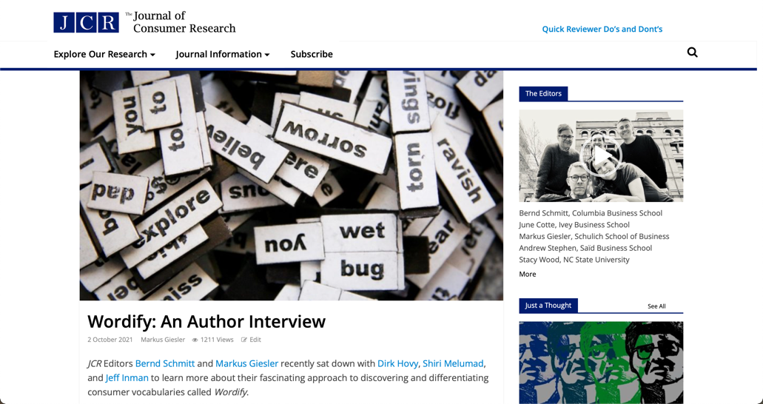



Author Interviews
Website/ Community

Slide 36
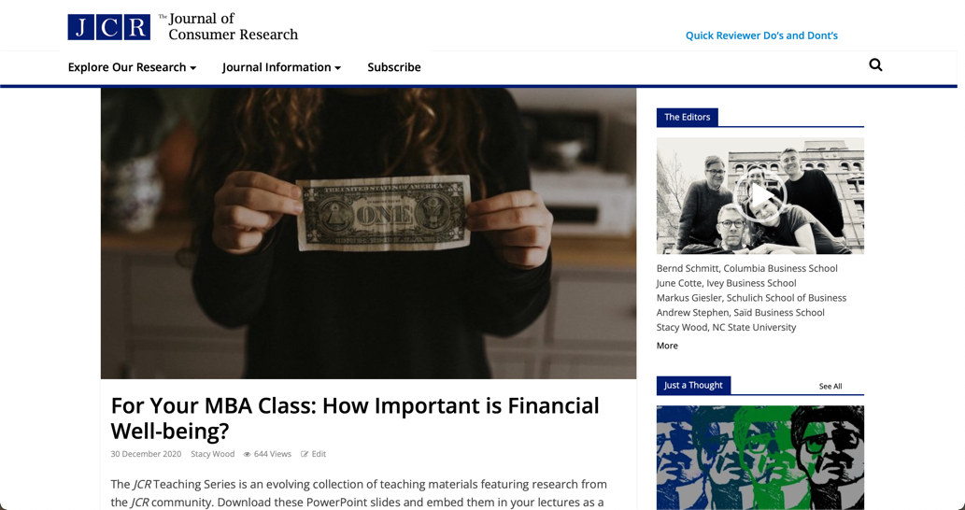
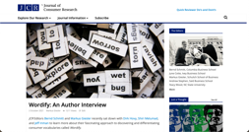
Teaching Series
Website/ Community

Slide 37

Just a Thought
Website/ Community

Slide 38
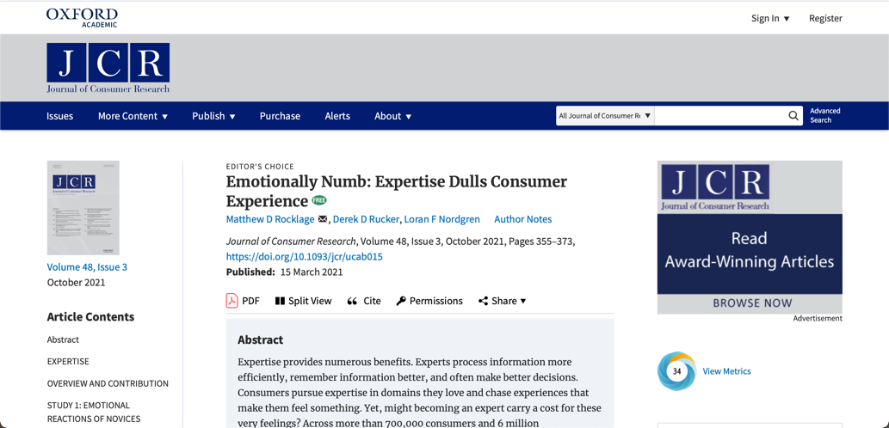
Editor’s Choice
Website/ Community

Slide 39
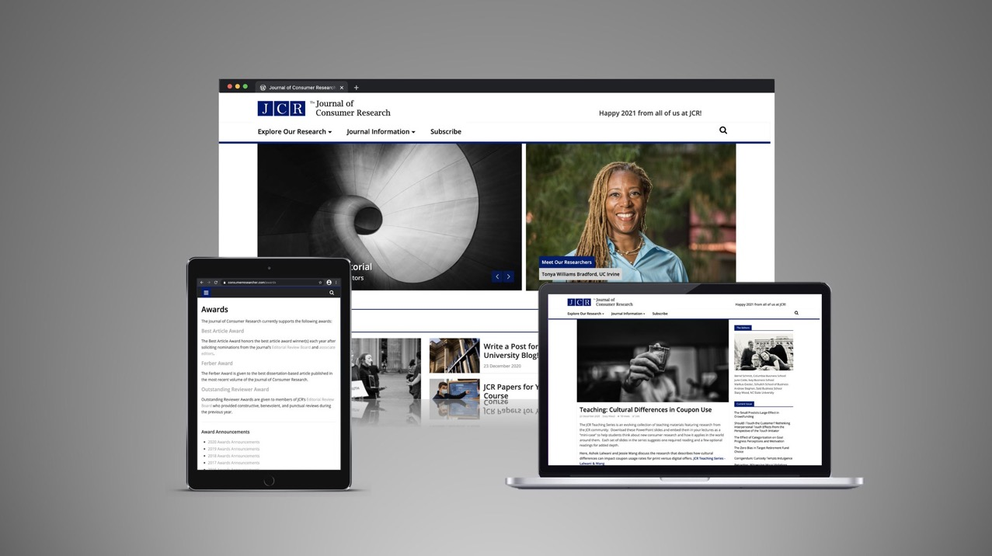

Slide 40
Website Performance
Website/ Community
300+
100+
Percent page view increase
Article-based content pieces
59
72
53
Percent female visitors
Percent non-US visitors
Percent Twitter sessions

Slide 41
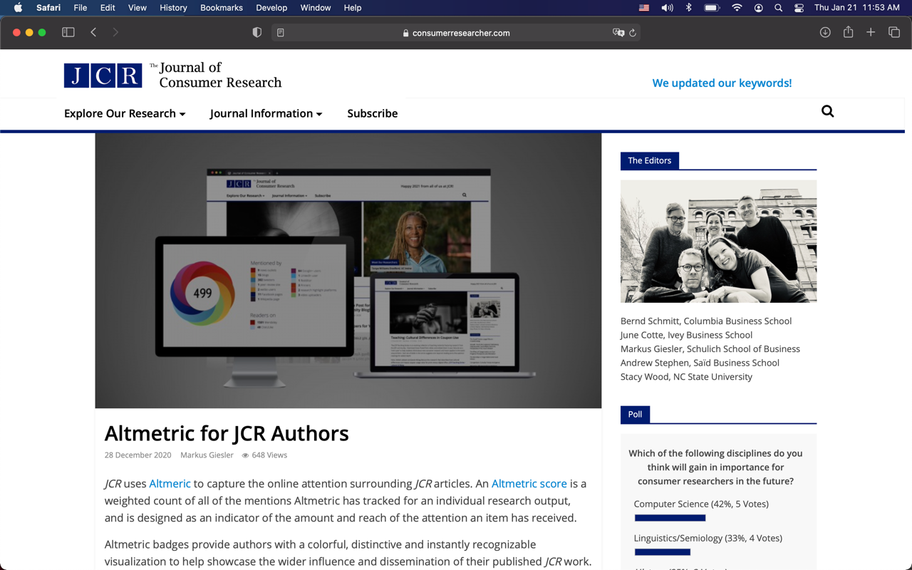

Slide 42
Altmetric Performance
Website/ Community
Annual OUP goal of median Altmetric score of 6.5 for 2021 content reached in Q1/2021.

Slide 43

FAQ
Flag papers that don’t have clear consumer relevance in your opinion.
Quickly review when you get the paper to check that data links work & the paper should go for review in your opinion.
Pay attention to category (e.g., distinguish between theory and sub/phen papers: for the latter, theory should be there but can be unproven but phenom data should be VERY compelling and “real”).
Don’t try to ‘average’ or ‘summarize’ reviewer opinions – take the most appropriate opinions and work from that.
What can I do to be a better AE?

Slide 44
FAQ
Remember that all authors share data when paper is submitted to JCR; it is there if you have questions about it.
Be timely (if you aren’t already).
Pay attention to category (e.g., distinguish between theory and sub/phen papers: for the latter, theory should be there but can be unproven but phenom data should be VERY compelling and “real”)
Weight “relevance/importance” heavily.
What can I do to be a better reviewer?

Slide 45
Thank you again!
Bernd Schmitt
Columbia University
June Cotte
Western University
Markus Giesler
York University
Andrew Stephen
Oxford University
Stacy Wood
NC State University

