Slide 1

Issues & Insights
Teaching Series
COVID-19 as an Innovation Accelerator
Stacy Wood & Cait Lamberton

Slide 2

Is a pandemic a good time for innovation?
Required Reading:
Why a Crisis Frees Us of Our Old Mental Models
Cait Lamberton & Stacy Wood, Medium
https://marker.medium.com/why-a-crisis-frees-us-of-our-old-mental-models-3cc8919bb55b
Notes:
As an alternative

Slide 3

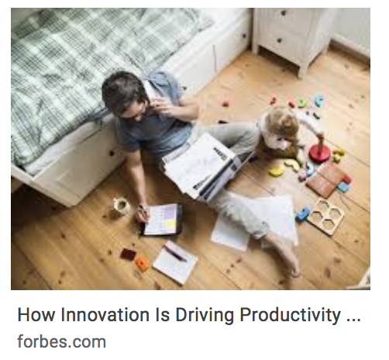


Examples of innovation during the 2020 pandemic

Slide 4
Teaching
Series
COVID-19 as an Innovation Accelerator
What does innovation need?
According to the reading, what happens during crisis times that helps with these factors?
What are other crisis-time benefits for these factors, in your experience?
Creativity
Problem-solving
Change-mindset
Time/concentration
Cooperation

Slide 5
Teaching
Series
COVID-19 as an Innovation Accelerator
Barriers to innovation?
What are some things that you can think of that hurt these factors during crisis times, especially the COVID-19 pandemic?
Creativity
Problem-solving
Change-mindset
Time/concentration
Cooperation

Slide 6
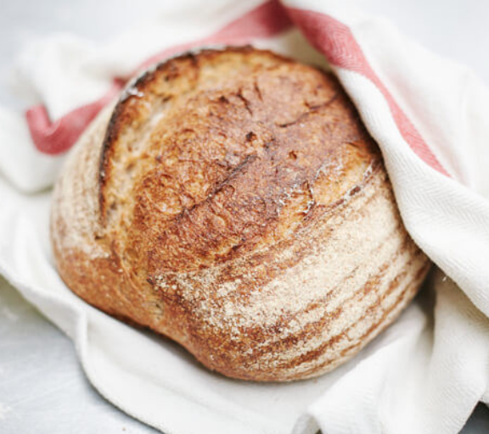
What do you think?
Down with perfectionism
Increased tolerance for trying, tinkering, fast fixes, and the value of “doing something"
Entrepreneurs need to be able to adapt ideas in real time and to see things that don’t work as just part of the process. Have businesspeople had more leeway to ”tinker” with new ways of doing things during the pandemic?

Slide 7
Teaching
Series
COVID-19 as an Innovation Accelerator
Upheaval sparks people to be “change-minded.” If we’re already learning new routines to go about our daily business, it unleashes our brains from the constraints of old habits. We aren’t on auto-pilot; we think more about what we are doing and that might make us think about doing things better or just differently. As one of the authors’ research shows, change often begets more change.
Just like we’re more likely to process familiar information when it’s presented in a surprising way, our now-foreign environment can slow us down to consider what we might still have to learn; questions that we might have considered answered are still open to discussion.
A Deeper Dive:
JCR papers to explore
Stacy Wood, The Comfort Food Fallacy: Avoiding Old Favorites in Times of Change, Journal of Consumer Research, Volume 36, Issue 6, April 2010, Pages 950–963, https://doi.org/10.1086/644749
Cait Poynor, Stacy Wood, Smart Subcategories: How Assortment Formats Influence Consumer Learning and Satisfaction, Journal of Consumer Research, Volume 37, Issue 1, June 2010, Pages 159–175, https://doi.org/10.1086/649906

