Slide 1

Issues & Insights
Teaching Series
Do consumers’ coupon redemptions depend on their cultural backgrounds?
Research from Ashok K. Lalwani and Jessie J. Wang

Slide 2


Do consumers’ coupon redemptions depend on their cultural backgrounds?
Required Reading:
Lalwani, Ashok K. and Jessie J. Wang (2019), “How Do Consumers’ Cultural Backgrounds and Values Influence
Their Coupon Proneness? A Multi-Method Investigation,” Journal of Consumer Research, 45 (5), 1037–50.
Notes:
As an alternative

Slide 3
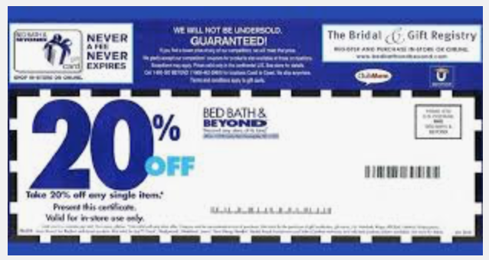
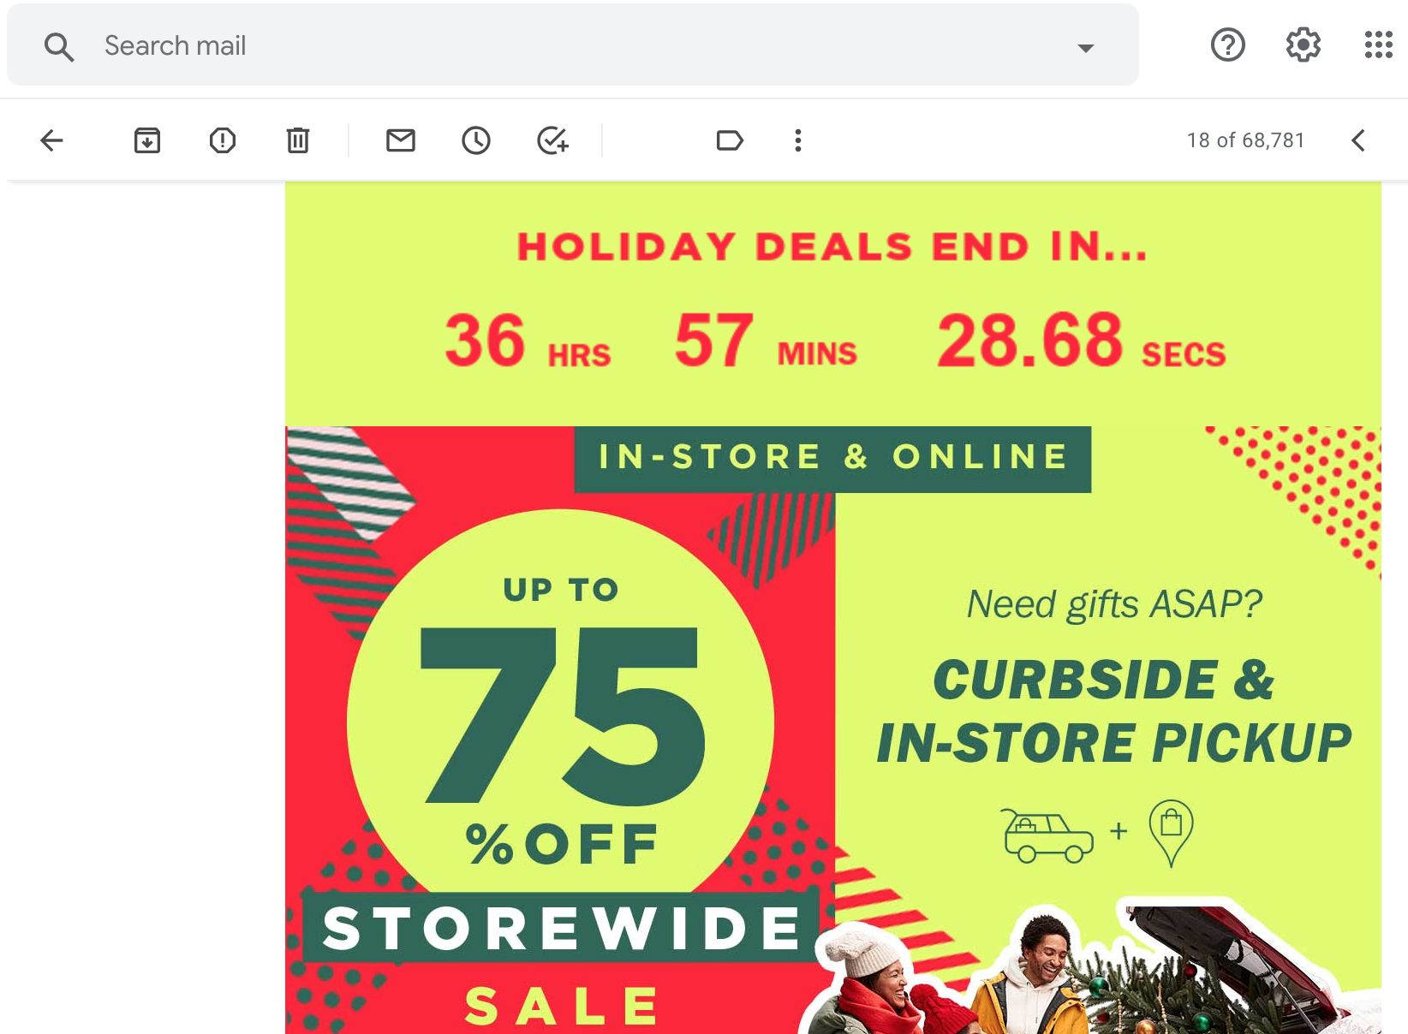

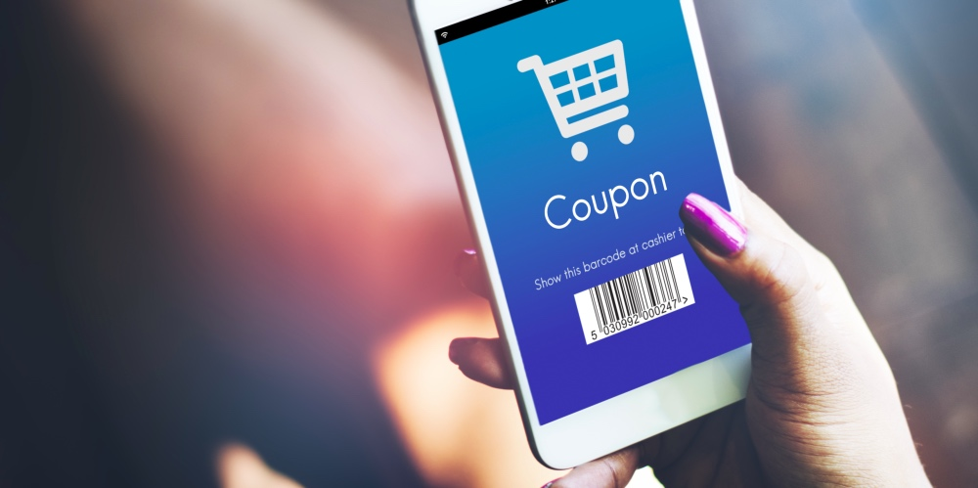
Free-standing print inserts: 0.5% to 2%.
Delivered through desktop channels: 2.7%.
Sent via a smartphone app: 8%-16%
Coupon redemption rates across channels
Notes:
Source: https://pointofsale.com/study-shows-roi-for-mobile-coupon-redemption/#:~:text=The%20widely%2Daccepted%20rates%20for,desktop%20channels%20is%20around%202.7%25.

Slide 4
Teaching
Series
What do you think?
Culture and Coupon Proneness
Why might managers wish to influence coupon redemption rates?
What factors might influence coupon redemption rates?
Of these, which factors can be controlled by marketers and which are outside their control?
Marketers and coupon redemptions

Slide 5
Self-Construal and Coupon Redemptions
Teaching
Series
Culture and Coupon Proneness
Consumers with an interdependent self-construal value benevolent relationships, maintaining and fostering in-group cohesion, harmony, camaraderie, and sociability.
Consumers with an independent self-construal value self-reliance, uniqueness, being distinct and separate from others, and seeking achievement and accomplishment.
Consequently, consumers with an interdependent self-construal are more likely to self-regulate their behavior.
Self-regulation translates to a greater willingness to persist with any or all steps involved in locating, clipping, collecting, organizing, saving and using coupons.

Slide 6
What do you think?
Based on the article, how might managers utilize knowledge of self-construal differences in coupon proneness to increase sales?
What kinds of contextual cues might increase or decrease coupon redemptions?

Slide 7
Teaching
Series
Culture and Coupon Proneness
A Deeper Dive:
Other papers to explore
Consumers with an interdependent (vs. independent) self-construal have been shown to be less likely to engage in impulsive consumption and to succumb to behaviors associated with a lack of self-control -- such as beer and alcohol drinking, display greater patience, and are less likely to crave immediate consumption.
It appears that this tendency also translates to greater effectiveness in activities requiring self-regulation, such as coupon proneness. Research awaits investigation of other phenomena that differ due to self-construal differences in self-regulation.
Argo, Jennifer J., and Kelley J. Main (2008), "Stigma by Association in Coupon Redemption: Looking Cheap because of Others." Journal of Consumer Research, 35, 4, 559-572.
William Ding and David Sprott (2019) ,"How Religiosity Shapes Coupon Usage", in NA - Advances in Consumer Research Volume 47, eds. Rajesh Bagchi, Lauren Block, and Leonard Lee, Duluth, MN : Association for Consumer Research, Pages: 538- 538.

