Slide 1

Jan
2021
ERB Meeting
Bernd Schmitt
Columbia University
June Cotte
Western University
Markus Giesler
York University
Andrew Stephen
Oxford University
Stacy Wood
NC State University

Slide 2

The following slides were presented during the January 21, 2021 JCR Editorial Review Board (ERB) meeting.
Note that the information was current at that time, but guidelines may change later as necessary. Also, note the Editors have now added a slide titled “Timeliness to Help Authors.” This slide was added to clarify issues surrounding the timeliness discussion during the ERB Meeting.
Notes:
As an alternative

Slide 3


Slide 4
A Big Thank You!
Notes:
As an alternative

Slide 5
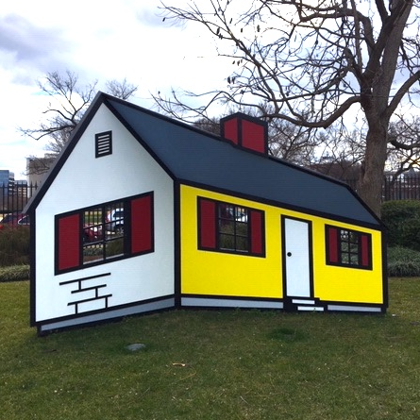

Strengthen
our platform to the world
Strengthen
our intellectual home

Slide 6



Platform
of Insights
Schmitt | Cotte | Giesler | Stephen | Wood
Our Journal, our Intellectual Home
Authors and contributors expect a transparent and fair as well as timely and speedy review process
Scholars and practitioners come to JCR for new and timely insight and data that they can trust
JCR includes a diverse and inclusive community of scholars that address consumer research issues from multiple perspectives
JCR is the premier journal on consumer research and a platform for consumer insight

Slide 7




Transparency
and Fairness
Timeliness
and Speed
Our editorship
will be guided by four principles
Diversity, Equity
and Inclusion
Community
Building

Slide 8
Platform
of Insights
Schmitt | Cotte | Giesler | Stephen | Wood
  Appointed AEs and members of the Editorial Review Board
  Revised submission guidelines (e.g., simplified, clarified and updated submission categories and author guidelines)
  Defined processes for reviewing papers
  Held forums/workshops
  Focused on DEI and data integrity
  Launched a new website and started outreach (consumerresearcher.com)
What Have We Done So Far?

Slide 9
Review and Publication Process
Transparency
and Fairness
Timeliness
and Speed
Bernd

Slide 10

Platform
of Insights
Schmitt | Cotte | Giesler | Stephen | Wood
Timeliness
and Speed
  Papers are 60 pages max (including title, contribution statement, abstract, full text, references, appendix, tables, figures)
  Papers are reviewed by ERB members and
  ad hoc reviewers
    You will get about 5 papers a year
    Please respond fast to an invitation to review: one business day
    Please complete review within 25 days
    Please write 3 pages max (if it is a revision only 1 page)
Reviewing JCR papers

Slide 11
Platform
of Insights
Schmitt | Cotte | Giesler | Stephen | Wood
Timeliness
and Speed
  Timeliness and speed can help authors get their work out to the world sooner.
  The following slide outlines our ideal review timing and process – if an author team wanted to get through the entire process to publication in one year, this timing on the next slide could get them there.
  However, we are mindful of the various personal circumstances facing the JCR author community. While we will ask for a revision to be completed in one year, exceptions can be granted, and authors are encouraged to reach out to the Editors if necessary.
Timelines to Help Authors

Slide 12
Overview of Review Rounds
Platform
of Insights
Schmitt | Cotte | Giesler | Stephen | Wood
 | RISKY | MAJOR | MINOR | TOUCH-UP | WHO? | REVIEW TIME
Round 1 | X | X | X | X | Ed, AE, 3 Rs | 6 weeks
Round 2 |  | X | X | X | Ed, AE, 3Rs | 6 weeks
Round 3 |  |  | X | X | Ed + AE | 3 weeks
Conditional Accept |  |  |  | X | Ed | 1 week
Length of Review | Max 3 pages | Max 3 pages | Max 1 page
Reasonable Requests | Create new framework, use new construct, and/or provide new data (max 50% of really new studies) | Some new ideas and/or new data (max 2 really new studies) | Rewriting of ideas and max one study redone in similar way to prior study and redo/add to analysis | Very minor writing changes and changes in illustrations
Percentage of Manuscripts | 30% | 60% | 95% | 100%
Revision time | 16 weeks | 12 weeks | 6 weeks | 2 weeks |  | 52 weeks

Slide 13
Platform
of Insights
Schmitt | Cotte | Giesler | Stephen | Wood
Transparency and Fairness
  A great paper is rigorous in its conceptualization and empirics
But this alone isn’t enough. A great JCR paper is more.
The paper provides new insight on an important topic
The paper shows how the topic is relevant to specific stakeholders
It strives for a major (“big”) theoretical or substantive contribution (rather than 5 little tweaks); if the paper reports experimental studies, it includes 4-5 great studies rather than 8-10 (or more) incremental studies
And don’t forget: A great paper is interesting. It minimizes jargon and is a pleasure to read.

Slide 14
Platform
of Insights
Schmitt | Cotte | Giesler | Stephen | Wood
Transparency and Fairness
Every author who submits a paper to JCR hopes for an R&R.
As Editors, Associate Editors and Reviewers we also look for
R&R
(Rigor and Relevance)
A “big” paper with new insight that is rigorous and relevant
Our job is to identify papers for JCR that have this potential. In reviewing the authors’ work we provide them with the opportunity to critically examine their ideas and data in order to produce a “big” paper. “Big” papers often provide a new lens or an elevated perspective; they break boundaries. However, papers within “normal science” also can be “big” by providing key new data (or moderators or boundary conditions) that address an established theory or phenomenon.

Slide 15
Platform
of Insights
Schmitt | Cotte | Giesler | Stephen | Wood
Transparency and Fairness
Think of yourself as evaluator/advisor/consultant; you are not the author and you should not want to become a co-author
Make constructive suggestions on how to improve the paper.
Be very clear on what is essential (“must be done”) and what is optional (“might be done”)
Help the AE and editor reach a decision. Be aware that there are additional reviewers that the the AE and editor need to consider as well.
Guiding Principles for Reviews

Slide 16
Transparency and Fairness
Reviewer DO’s
Ask the “So what?” question
Push for clarification and possible solutions
Highlight conceptual and empirical issues
Use a structure (e.g., number your points)
Strive for “good enough”
Reviewer DON’T’s
Stream-of-consciousness review
Condescending, patronizing tone
Highjack the paper
Make your research the focus of the paper
Ask for radical pivots in rounds 2 and 3

Slide 17
Platform
of Insights
Schmitt | Cotte | Giesler | Stephen | Wood
Transparency and Fairness
There is no template for the ideal JCR paper. However, there are broad guiding principles for evaluating different types of papers:
  Conceptual paper
  Theory-driven empirical paper
  Substantive phenomenon paper
  Consumer culture theory (CCT) paper
  (Multi-)methods and empirical quant paper
To be transparent and fair, we will draft guiding principles based on forums/workshops that we are currently holding with Associate Editors
An Ideal
JCR Paper

Slide 18
Conceptual paper
Platform
of Insights
Schmitt | Cotte | Giesler | Stephen | Wood
Transparency and Fairness
What does it do?
  Focuses on a new entity
  Presents a theory or typology and integrates prior work theoretically
  Advocates a certain position
Evaluation criteria
  Because there won’t be data, does the the paper appropriately use conceptual thinking skills (e.g., identifying, delineating, differentiating, advocating, integrating, refuting)?
  Is the idea clear, compelling, comprehensive, coherent and adequately represent prior research?
  Is the idea generative of new research ?
  NOTE: The focus is on logic, arguments, creativity. No data needed.

Slide 19
Theory-driven empirical paper
Platform
of Insights
Schmitt | Cotte | Giesler | Stephen | Wood
Transparency and Fairness
What does it do?
  Applies a theory (or key claims of a theory) in the context of CB
  Uses a methodology (e.g., lab experiments) to test the theory or claims
  Includes manipulations or interventions rather than measures or observations
Evaluation criteria
  Are the theory and the CB context appropriately connected?
  Is the empirical package complete?
  Does the empirical package provide evidence for all the claims of the theory?
  NOTE: The focus is on theory and testing. Arguments for realism and relevance should be provided in the paper but are less essential in the studies

Slide 20
Substantive phenomenon paper
Platform
of Insights
Schmitt | Cotte | Giesler | Stephen | Wood
Transparency and Fairness
What does it do?
  Investigates an important, contemporary CB phenomenon
  Provides multiple evidence for the phenomenon and its nature
  Identifies a mechanism why the phenomenon occurs
  Shows that the phenomenon is consequential (that is, is real and relevant)
Evaluation criteria
  Is the CB phenomenon well documented and delineated?
  Is there sufficient empirical evidence for the phenomenon?
  Is an independent mechanism presented and evidence for it presented?
  Is the relevance of the phenomenon explored
  NOTE: The focus is on studying an important phenomenon. The mechanisms and processes do not need to be extensive, fully conclusive and extremely detailed

Slide 21
CCT paper
Platform
of Insights
Schmitt | Cotte | Giesler | Stephen | Wood
Transparency and Fairness
What does it do?
  Focuses in depth on a CB phenomenon in its socio-cultural context
  Uses contemporary ethnographic and sociological methodologies and analyses
  Utilizes a key social/cultural theory or constructs to abstract the phenomenon to show its general CB significance
Evaluation criteria
  Is the paper complete, coherent, and fair vis-à-vis the status quo in CCT research?
  Is the paper methodologically transparent, timely and reliable for studying the phenomenon?
  Are implications for CCT (and CB more generally) sufficiently developed?
  NOTE: The focus is on depth and details to make a case for an important phenomenon. Data do not need to be exhaustive or representative.

Slide 22
(Multi-)methods and empirical quant paper
Platform
of Insights
Schmitt | Cotte | Giesler | Stephen | Wood
Transparency and Fairness
What does it do?
  Provides a new methodology of great relevance to consumer research
  Mixes multiple methods (e.g., qual/quant data, field/lab data; etc.)
  Examines as an empirical model consumer behavior and alludes to theories and a process in CB
Evaluation criteria
  Are the data (and analyses) well-chosen?
  Are the assumptions of the method realistic for CB?
  Does the approach provide value (beyond methodological sophistication) and insight for CB?
  NOTE: The focus is on data and methodology. Theoretical and detailed substantive issues should be addressed but it is less important to resolve them in detailed ways

Slide 23
Topic Areas
Platform
of Insights
Schmitt | Cotte | Giesler | Stephen | Wood
Transparency and Fairness
Innovation (e.g., technology, social media, AI, AR/VR)
Social cognition (e.g., perceptions, info processing, goals, affect)
Judgment and decision-making (e.g., descriptive and normative decisions, attitudes, choice)
Marketing response (e.g., brand, communications, product features)
Social influence (e.g., motivations, groups, signaling)
Socio-cultural and societal issues (health, crisis, mobility, environment)
To be transparent and fair, we will also draft broad evaluation criteria for each topic area.

Slide 24
Specific criteria in topic areas
Platform
of Insights
Schmitt | Cotte | Giesler | Stephen | Wood
Transparency and Fairness
Innovation: Is the technology current? Does the paper relate the innovation/technology to CB issues? Do the studies present realistic uses of the innovation?
Social cognition: Does the paper address consumer issues (not general cognitive psychology issues)? Is the paper at the right level of analysis to be relevant?
Judgment and decision making: Are the judgements and decisions consumer relevant? Is there some insight of why and how the decisions occur?
Marketing response: Is the paper focused on CB issues, and not marketing issues of the firm? Are the stimuli realistic and consumer relevant?
Social influence: Is the paper focused on CB issues (beyond pure social psychology)? Is the social nature well conceptualized and studied?
Socio-cultural and societal issues: Does the paper use an abstracted and fair perspective? Are the examples, concepts and methods used in an unbiased way?

Slide 25
Platform
of Insights
Schmitt | Cotte | Giesler | Stephen | Wood
Transparency and Fairness
Title: simple, attention getting, informative (not convoluted, full of jargon, or just cute)
Abstract should provide key information about what is done and how it is done and describe key conclusions
Keywords should be well chosen for referencing
Introduction should motivate, clearly lay out CB issue
Discussion should indicate how CB issue was addressed and what new research emerges
Writing: Active, straightforward writing (with examples and no unnecessary jargon)
Illustrations (Figures, Tables): They are not decorations but should display the essential parts of the paper, and, ideally, tell the story
Appendices and Web Appendices should only be used if necessary and written with an eye toward the reader (not to please reviewers)
Style of the Paper:
A JCR paper is a professional article that attracts attention, and gets read and cited, for its reliable consumer insight

Slide 26
Platform
of Insights
Schmitt | Cotte | Giesler | Stephen | Wood
Transparency and Fairness
The five editors meet regularly together with the Managing Editor
Discuss the submission of papers
Progress of papers to ensure timeliness, fairness, consistency
Discuss publications (when, which order in issue etc.)
Research Curations and Special Issues
Major projects
We have formulated guidelines for desk rejections, appeals and how to handle papers from prior editorial team(s).
Editors Management

Slide 27
Platform
of Insights
Schmitt | Cotte | Giesler | Stephen | Wood
Transparency and Fairness
DESK REJECTION
Immediate desk rejects: No fit; no sense of what JCR is looking for; very poor paper overall with not enough rigor
  No further action
Wrong objective: Too “grand” (and unspecific) or too “small” (and obsessively detailed)
  Maybe resubmission; if there is sufficient detail in the “grand” paper on a key CB issue or if there is an indication that the “small” paper could improve through abstraction or generalization
No relevance: Paper is not focused on a CB issue
  Maybe resubmission; if it easily could be about a relevant CB issue, ask authors to resubmit with a unique, relevant focus on CB
NOTE: Decision is made by Editor-in-Chief (obvious cases) or by an Editor, at times together with an AE. Each resubmitted paper must be considerably different to be reviewed again.

Slide 28
Platform
of Insights
Schmitt | Cotte | Giesler | Stephen | Wood
Transparency and Fairness
PAPERS FROM PRIOR EDITORS
A new editor will be selected by the editor-in-chief in consultation with the entire team. The AE will usually remain the same. Reviewers may stay the same, or some exchanged.
If one of the appointed editors is currently the AE, then that person will be the new editor of the paper. A new AE will be appointed in cases of risky and major revisions (can be one of the reviewers).
The paper will be subject to the same process as any new paper; criteria of rigor, relevance and other criteria will be reasonably applied. Papers with minor revisions are very likely to move toward publication.
Alive papers of the new editors will go to the Special Guest Editor

Slide 29
Who Gets Which Paper?
Platform
of Insights
Schmitt | Cotte | Giesler | Stephen | Wood
 |  | 1st | 2nd | 3rd
Conceptual |  | Bernd | Markus | June
Theory-based |  | June | Stacy | Andrew
Substantive |  | Stacy | Andrew | Bernd
CCT |  | Markus | Bernd | Stacy
(Multi-)methods and empirical quant |  | Andrew | June | Markus
Topic Areas Innovation (social media, tech products and new technologies such as AI,AR/VR) Social cognition (perceptions, info processing, goal, affect) Judgment and decision making Marketing response (brand, communications, product features) Social influence (motivations, groups, signaling) Socio-cultural and societal issues (health, crises, mobility, environment) |  | Andrew Stacy Stacy Bernd June Markus | Stacy Bernd Andrew Andrew Markus June | Bernd Markus June June Andrew Stacy

Slide 30
Questions?

Slide 31
Data Policies
Transparency and Fairness
Andrew

Slide 32
Data policies and scientific integrity
Platform
of Insights
Schmitt | Cotte | Giesler | Stephen | Wood
Transparency and Fairness
Important to note that the JCR Policy Board, not the Editors, sets policies on data and scientific integrity.
Recent changes (from 1 Oct 2020) to
  Data collection paragraph requirements
  Open science and research transparency guidelines
  Providing data upon submission and archiving
  Data maintenance policy

Slide 33
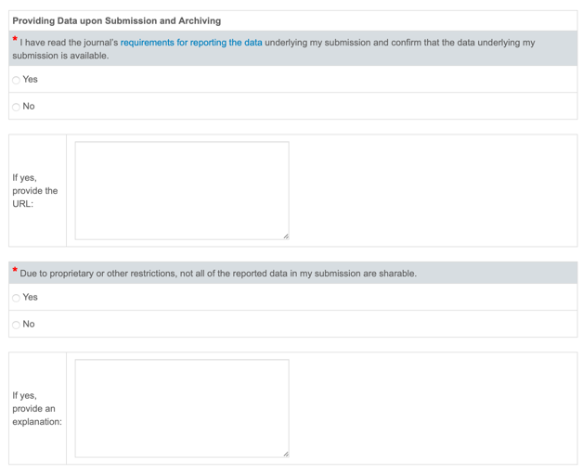
Requirement at submission
Effective 1 October 2020
Platform
of Insights
Schmitt | Cotte | Giesler | Stephen | Wood
Transparency and Fairness

Slide 34
Data policies and scientific integrity
Platform
of Insights
Schmitt | Cotte | Giesler | Stephen | Wood
Transparency and Fairness
Important to note that the JCR Policy Board, not the Editors, sets policies on data and scientific integrity.
Recent changes (from 1 Oct 2020) to
  Data collection paragraph requirements
  Open science and research transparency guidelines
  Providing data upon submission and archiving
  Data maintenance policy
The new policy on data availability will have been in place 3 months when we start, and our plan is to watch its implementation closely to identify further steps to be taken.

Slide 35

DEI
Diversity
and Inclusion
June

Slide 36
Platform
of Insights
Schmitt | Cotte | Giesler | Stephen | Wood
Diversity
and Inclusion
We recognize that the playing field is not level for
all authors; fairness requires careful consideration of the different realities experienced in our field.
Consumer research is involved with identifying and then solving difficult problems facing consumers, marketers, and policy makers; some of these are really hard problems.
The more diverse the problem solvers, the greater the group’s ability to find innovative solutions to difficult and complex problems.

Slide 37
Platform
of Insights
Schmitt | Cotte | Giesler | Stephen | Wood
Diversity
and Inclusion
Three Broad Levels
  DEI in journal management - measure and set goals for participation on ERB, as AEs, and ad-hoc reviewers.
  DEI in journal content – encourage work on unrepresented consumer groups.
  DEI “inside” the article – training and awareness for authors and reviewers to be looking for inherent and often implicit racist, sexist, etc. operationalizations.
Principle
Broaden the circle of voices that matter.

Slide 38
Platform
of Insights
Schmitt | Cotte | Giesler | Stephen | Wood
Diversity
and Inclusion
Gibbs and Marsteller (2016): “Why would we not do everything we can to broaden participation? The system we have has served us well, but it needs to evolve in a manner that will serve us optimally in the future. As there is no evidence that scientific potential or ability are coupled with the social and demographic categories we use to describe ourselves, broadening participation will allow the…community to cultivate and harness all available talent to identify and address pressing scientific and societal concerns.”
Indeed.

Slide 39

Communications and Technology
Community
Building
Stacy and Markus

Slide 40
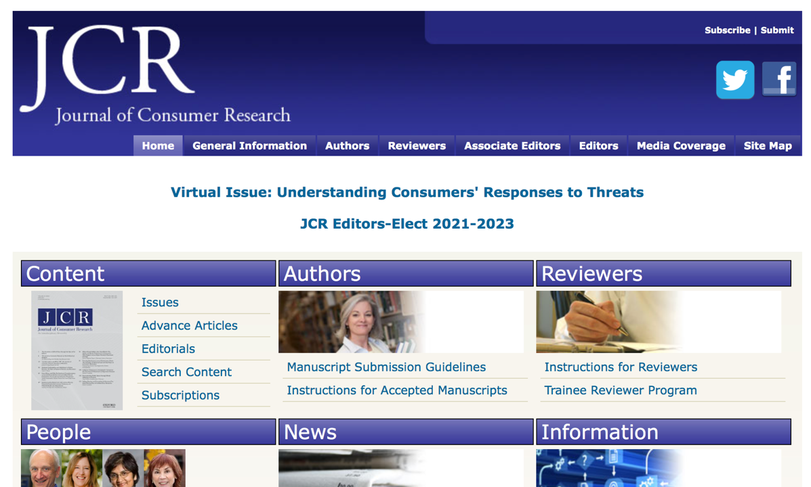

Slide 41
consumerresearcher.com
On January 1, 2021, we launched our new journal platform

Slide 42


Slide 43
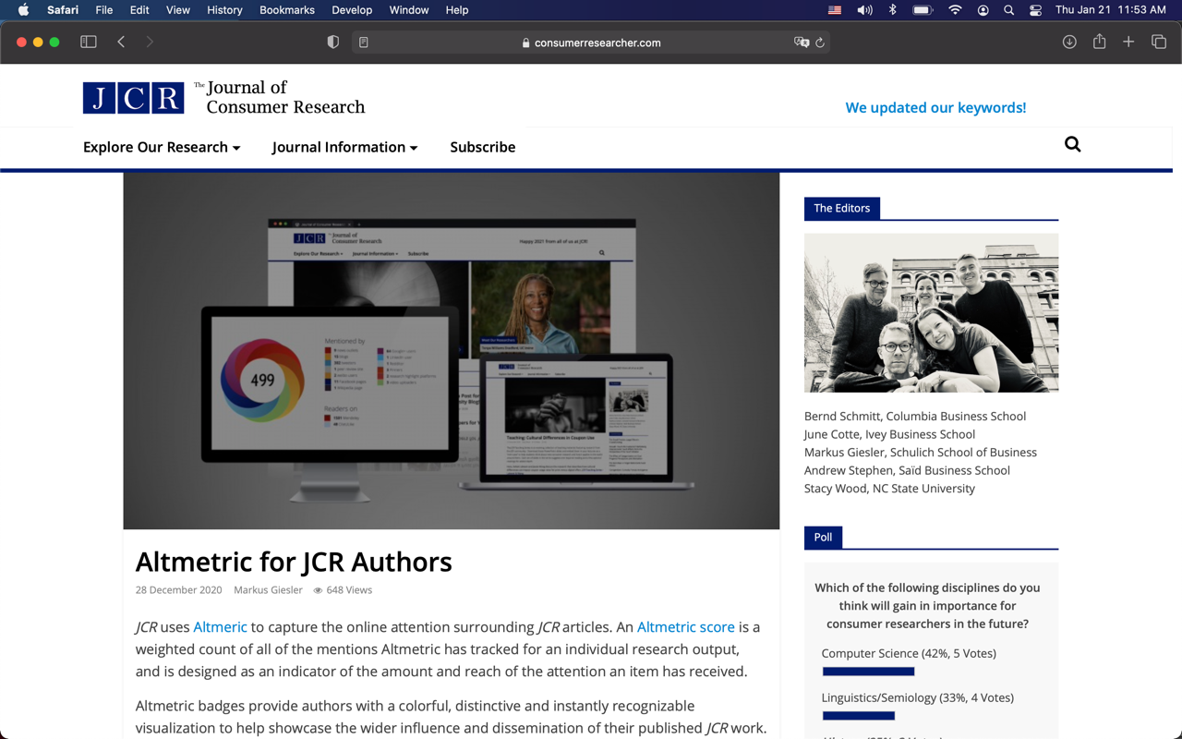

Slide 44
Platform
of Insights
Schmitt | Cotte | Giesler | Stephen | Wood
Community
Building
Special Content Initiatives
We will continue to run curations
  Focused on relevant topics
  Published in the journal
We plan to launch special issues:
  Special Issue on 50 years of JCR (to be published mid-2024). Some papers will be invited papers; other (shorter papers) will be submitted based in Call for Papers
  Another couple of issues on topics to be determined
There will also be special content on the web site related to published articles and relevant issues. We also invite the community to reflect on issues, interact and debate. JCR as a brand is more than the papers published in the journal.
Principle
Nurture JCR identities, connections, communications.

Slide 45
Platform
of Insights
Schmitt | Cotte | Giesler | Stephen | Wood
Community
Building
Two Purposes:
Author and Audience Benefit
Authors
Motivate and celebrate
Translation training
Connect to resources
Audience
Teach and spread
Use in real life
Generate interest and inspiration

Slide 46
Two arenas:
Inside and Outside JCR
Community
Building
Better Communication
Inside JCR
Professional connections
Knowledge sharing
Outside JCR
Paper promotion
Reputation building

Slide 47
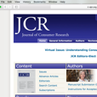

INSIDE OUTSIDE
Author
Coordinated panel content
Author socials
Audience
Special topic forums
Brown-bags
Job news
Author
Tenure-oriented info
Connections to industry or public policy
Citations
Audience
Shareable info
Useable info
Citations
Author
Guest columnist
Poster session at ERB mtg
Audience
Teaching materials
Interactives
“Stay Current” content
Author
Press releases
Media guidance
Translation training
Audience
Podcasts
Short video series
Interdisciplinary reports
Professional connections
Knowledge sharing
Paper promotion
Reputation building

Slide 48
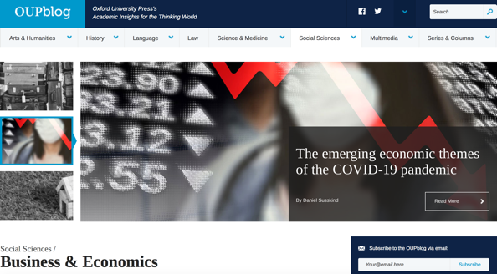
Utilize OUP:
4 initiatives to connect to other disciplines
Platform
of Insights
Schmitt | Cotte | Giesler | Stephen | Wood
Community
Building
Push material to OUP blog
Targeted use of rented mailing lists
Strategic use of “free for a limited time” collections
New use of the OUP table at conferences

Slide 49
Platform
of Insights
Schmitt | Cotte | Giesler | Stephen | Wood
Community
Building
How the website is designed indicates
the purpose for which it will be used…
Current – as a place where submitting authors to come a few times a year to get information about submission and outsiders come occasionally to see what the journal is all about.
Future – as a place where consumer researchers come daily to “check the consumer research news” and outsiders come occasionally to see what consumer research is all about.

Slide 50
Questions?

